Slide 1
Project Fake Taxi
Colin Bossuyt, Xander Vyvey, Alberiek Depreytere and Esteban Desmedt

Slide 2

Table of contents
The role of each team member
The problem statement
The proof of concept
The prototype of the product
The planning
Some final thoughts on the project

Slide 3
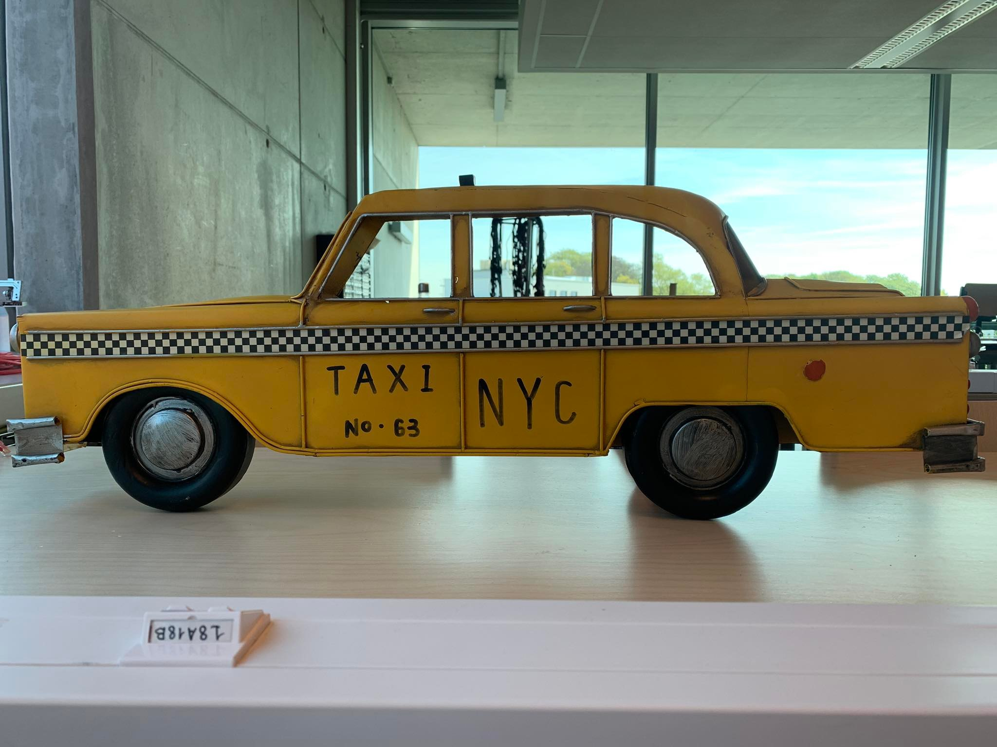
Meet our team

Slide 4
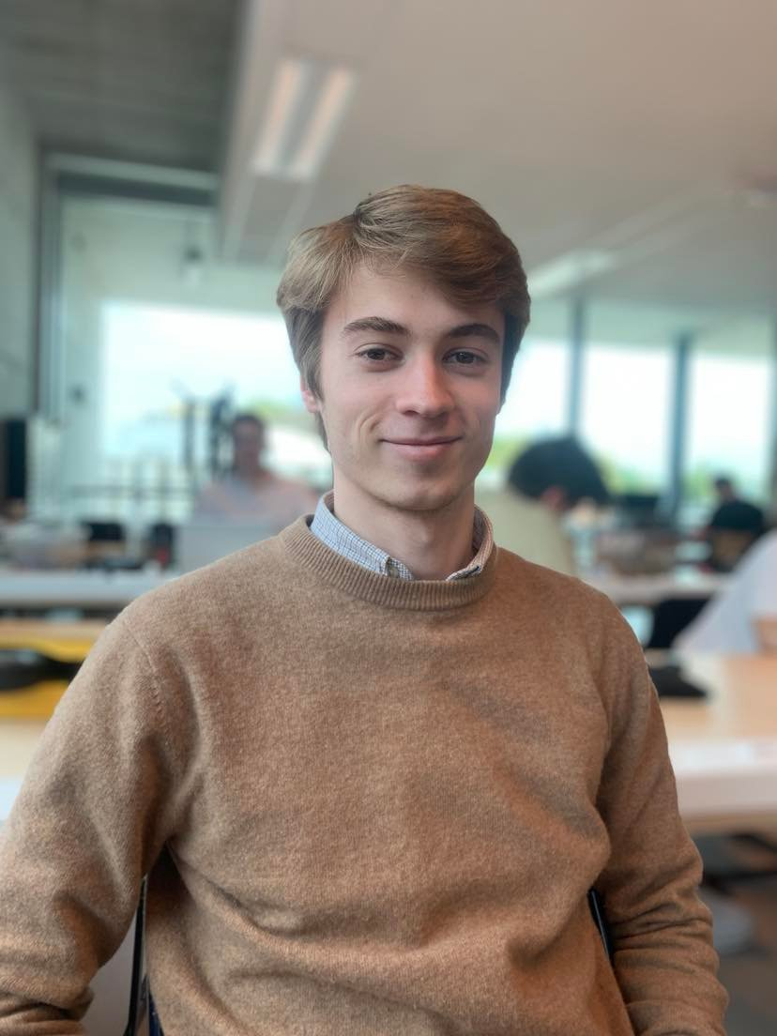
Colin Bossuyt (CEO fake taxi INC.)
3D prints
Engine drive

Slide 5
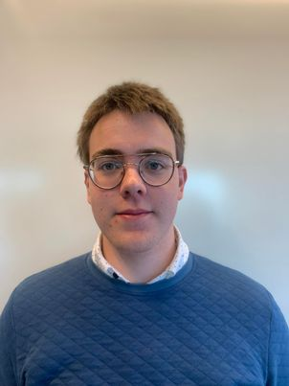
Alberiek Depreytere (Lead sound executive)
Speaker
Elektronica
(speaker)

Slide 6
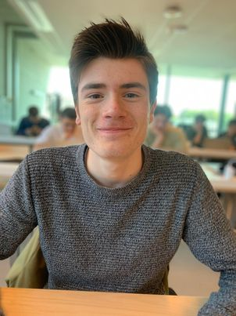
Xander Vyvey (CTO fake taxi INC.)
Mechanica
Engine drive

Slide 7

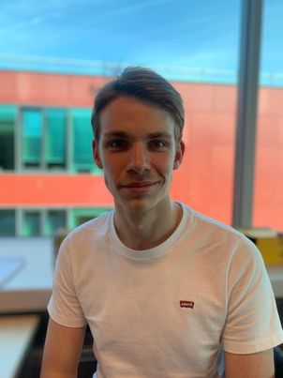
Esteban Desmedt (Employee of the month)
Software
Engine drive

Slide 8



Problem

Slide 9
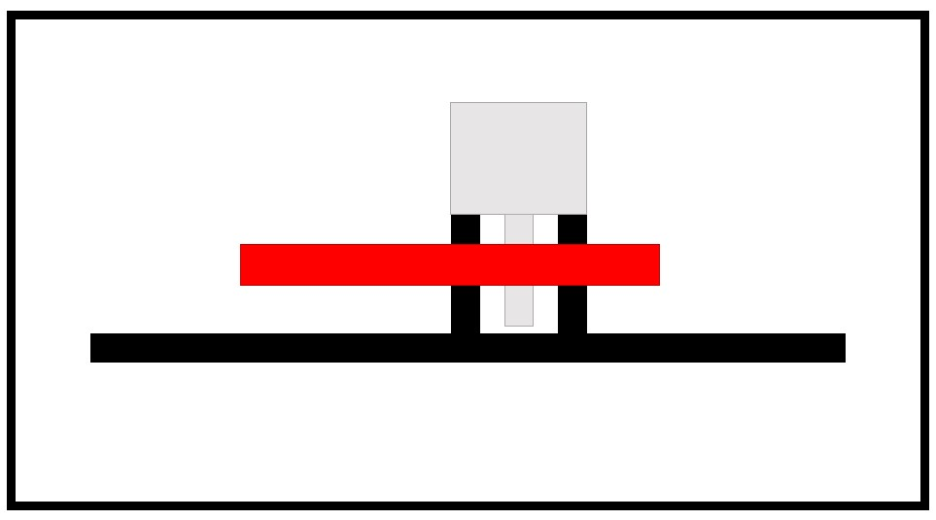
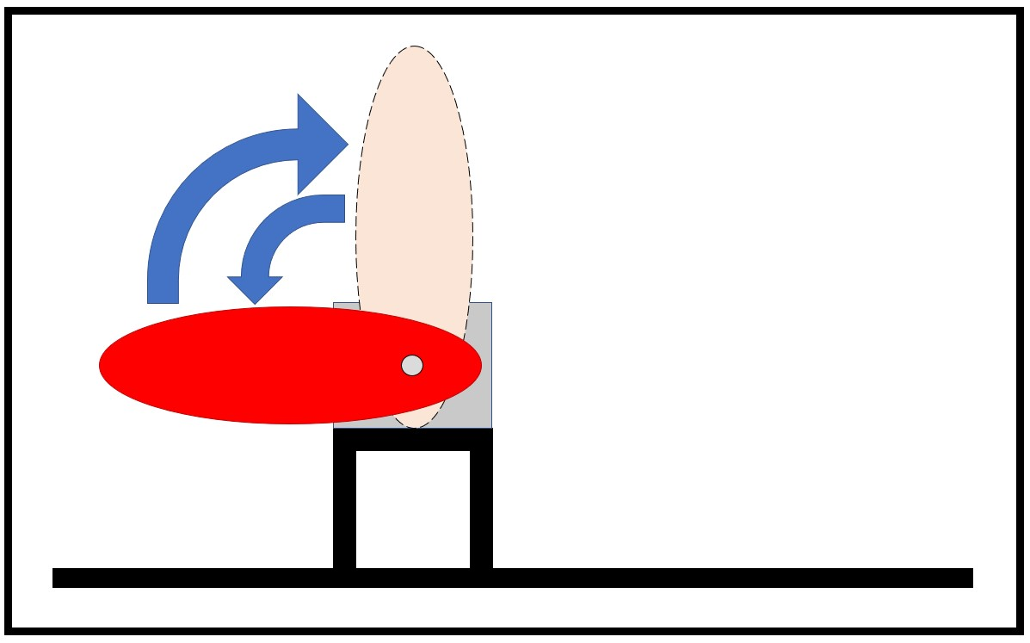
Concept

Slide 10
Prototype

Slide 11
Planning

Slide 12
Final thought?

